Slide 1
Stock Splits
Examples

Slide 2
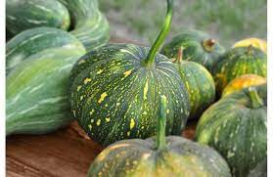
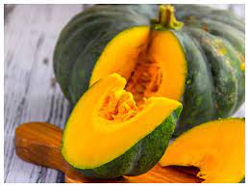
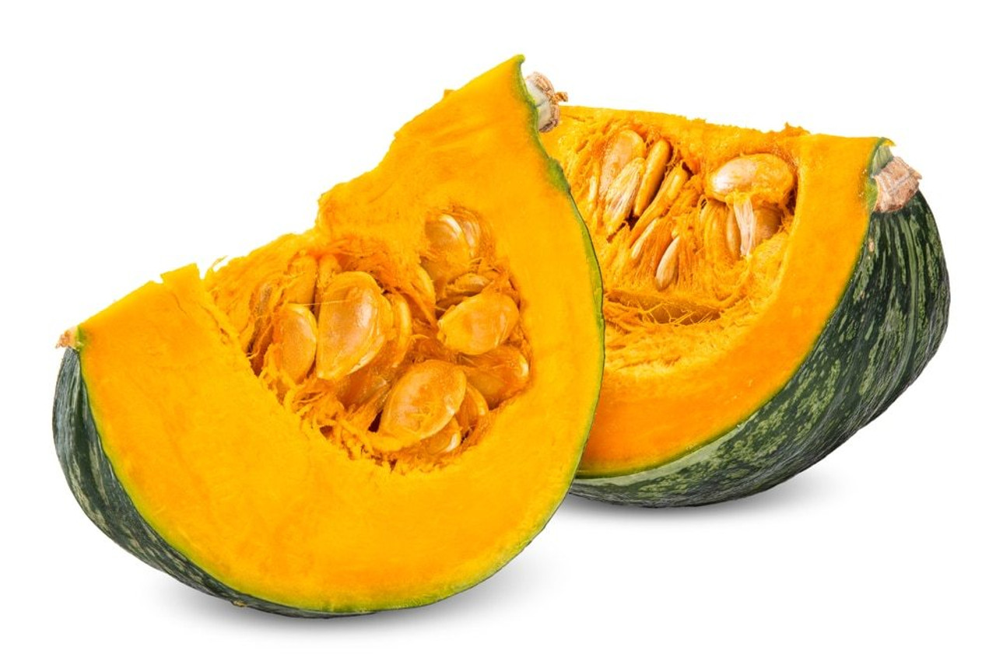
Pumpkin Sellers

Slide 3
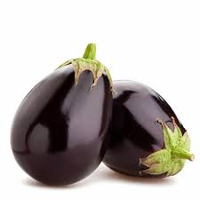
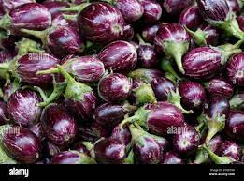
Brinal Sellers

Slide 4
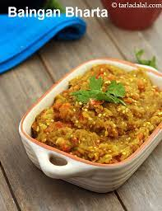
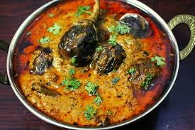
Assuming one is indifferent between
Baigan ka Bharta and Baigan Korma
Typically using big size brinjals
Typically using small size brinjals

